Slide 1

Weak Hiding for C++ Concepts
and a Generic Way to Understand Name Binding
Larisse Voufo, Marcin Zalewski, Jeremiah Willcock and Andrew Lumsdaine
Center for Research in Extreme Scale Technologies (CREST)
Indiana University
C++Now 2013, Aspen, CO, USA
Notes:
This came as a result of my work with ConceptClang, where I implement C++ concepts in Clang…

Slide 2
Objectives
A simpler way to describe name binding.
A more powerful way to describe name binding.
Applying this description to C++ concepts.

Slide 3
Our Tools
scope combinators,
an abstraction of programming languages, and
a distinction between name lookup and name resolution.

Slide 4
Outline
Current name binding mechanisms:
  Across languages.
  Specific to C++:
    Argument-dependent lookup (ADL).
    Uses of operators.
A new scoping rule: Weak hiding
  Implementation: two-stage name binding (Bind^{x2})
  Application: Preventing code breakage when switching to concepts-enabled libraries.

Slide 5
Name Binding
Deciding what a particular use of a name refers to.
Use of a name = a reference; What it refers to = a declaration.
void foo();
void foo(int, double);
void test() {
foo();
}
?
Notes:
In programming languages, …

Slide 6
Name Binding
Binds a reference to a declaration.
void foo();
void foo(int, double);
namespace ns { void foo(int); }
void test() {
using ns::foo;
foo();
}
?
?
Notes:
In C++ standard terminology, name binding tells us
which declaration is best viable for the reference.
New names can be introduced from different regions of code (or declarative regions in C++ standard terminology)…

Slide 7
Name Binding
Binds a reference to a declaration.
?
void foo();
namespace adl { struct X {};
void foo(X); }
namespace ns { void foo(int); }
void test(adl::X x) {
using ns::foo;
foo(x);
}
?
?
Notes:
… and in the presence of argument dependent lookup …

Slide 8
Name Binding
Binds a reference to a declaration.
concept Foo2<typename P> =
requires (P a, P b) { foo(a, b); }
void foo(int) { }
template<Foo2 T>
void gen_func(T a, T b) {
foo(a, b);
foo(1);
}
?
?
Notes:
… and more particularly to an issue we would have with concepts enabled for C++…

Slide 9
Name Binding
Depends on a scope, nested or combined with other scopes.
void foo();
namespace adl { struct X {};
void foo(X); }
namespace ns { void foo(int); }
void test(adl::X x) {
using ns::foo;
foo(x);
}
::
adl
ns
test
Notes:
Scope = collection of declarations, for a given reference …
While declarations in a given scope hide others in other scopes,
others are treated equally.

Slide 10
Name Binding
Differs between languages, designs, or kinds of references:
  argument-dependent lookup (ADL),
  simple function calls,
  uses of operators,
  uses of types,
  C++ Multimethods,
  C++,
  Haskell,
  etc…
::
void foo();
namespace adl { struct X {};
void foo(X); }
namespace ns { void foo(int); }
void test(adl::X x, adl::X y) {
using ns::foo;
foo(x + y);
}
adl
ns
test
Notes:
Therefore, we want to describe it generically…

Slide 11
Standards for Name Binding
Can be challenging to understand, analyze, and compare.
Are intertwined with other sections of the standard.
C++ Name Binding Specification, at a glance:
  3.4 – Name lookup 13 pages, 45+ paragraphs
  14.6 – Name resolution 13 pages, 50+ paragraphs
  13 – Overloading 30 pages, 140+ paragraphs
  11 – Member access 10 pages, 35+ paragraphs
Notes:
The problem we are addressing has to do with name binding specifications.

Slide 12
Standards for Name Binding
Typically depend on details of languages and the varied features they support.
ConceptC++:
template<Foo2 T>
void test(T) {
foo();
}
Haskell:
test::Foo2 t => t -> ()
test _ = foo()
Hindley-Milner type system + Type classes
Type inference + Dependency analysis
Dictionary-passing style
Modules and import declarations
Haskell compilers, e.g., GHC, Hugs, NHC, …
Etc…
C++ templates + Concepts
(Non)dependent names
Overload resolution
Namespaces + using declarations
C++ compilers, e.g., GCC, Clang, …
Etc…
Notes:
Don’t forget the kind of the reference, i.e., uses of operators, types, special members, etc…

Slide 13
Standards for Name Binding
Are understood differently by different compilers.
namespace adl { struct X {};
void foo(X); }
namespace ns { void foo(int); }
void bar(adl::X x) {
using ns::foo;
foo(x);
}
void baz(adl::X x) {
void foo(int);
foo(x);
}
In bar():
  Success. ADL enabled.
  Binds foo(x) to adl::foo().
In baz():
  GCC, Clang, Comeau:
  Failure. ADL Disabled.
  foo(x) does not match baz::foo(int).
  Intel:
  Success.
Notes:
ADL…

Slide 14
Standards for Name Binding
Are understood differently by different compilers.
struct X {}; struct Y {};
void operator+(X, X) { }
void operator+(X, Y) { }
void test(X x, Y y) {
void operator+(X, X);
x + x;
x + y;
operator+(x, x);
operator+(x, y);
}
GCC, Clang, MS Visual Studio editor :
  x + y succeeds.
  operator+(x, y) fails.
Intel, MS Visual Studio:
  x + y succeeds.
  operator+(x, y) succeeds.
Comeau:
  x + y fails.
  operator+(x, y) fails.
Notes:
Uses of operators…

Slide 15
Standards for Name Binding
Gain complexity with the addition of concepts,
breaking seemingly valid codes.
concept Foo2<typename T> =
requires (T a, T b) { foo(a, b); }
void foo(int) { }
template<Foo2 T>
void gen_func(T a, T b) {
foo(a, b);
foo(1);
}
?
?

Slide 16
Name Binding Specifications
Gain complexity with the addition of concepts,
breaking seemingly valid codes.
::
concept Foo2<typename P> =
requires (P a, P b) { foo(a, b); }
void foo(int) { }
template<Foo2 T>
void gen_func(T a, T b) {
foo(a, b);
foo(1);
}
Foo2<P>
Foo2<T>
template…
gen_func<T>
Notes:
Breaking things down into scopes.
What happens to declarations that are brought in by the constraints on the template?

Slide 17
Name Binding Specifications
Gain complexity with the addition of concepts,
breaking seemingly valid codes.
::
concept Foo2<typename P> =
requires (P a, P b) { foo(a, b); }
void foo(int) { }
template<Foo2 T>
void gen_func(T a, T b) {
foo(a, b);
foo(1);
}
Foo2<T>
Should Foo2<T>::foo()
shadow ::foo()? How?
Reject or accept the call foo(1)?

Slide 18
Our Name Binding Framework
Specifies name binding.
::
void foo();
namespace adl { struct X {};
void foo(X); }
namespace ns { void foo(int); }
void test(adl::X x) {
using ns::foo;
foo(x);
}
adl
ns
test
Bind
Best viable candidate, or
error
Notes:
Name binding = a process that takes a reference and the knowledge that we have about
the context of the reference, e.g., scopes, and returns either
the best viable candidate or an error.

Slide 19
Our Name Binding Framework
Specifies name binding, independently of the language.
Identify and combine scopes.
::
void foo();
namespace adl { struct X {};
void foo(X); }
namespace ns { void foo(int); }
void test(adl::X x) {
using ns::foo;
foo(x);
}
adl
Execute generic name binding.
ns
test
Bind
Best viable candidate, or
error
Notes:
Express the combination of scopes in an abstract representation (intermediate language).
Execute name binding based on that representation (taking it as input parameter), independently of the language.

Slide 20
Our Name Binding Framework
Specifies name binding, independently of the language.
Express scoping rules.
::
void foo();
namespace adl { struct X {};
void foo(X); }
namespace ns { void foo(int); }
void test(adl::X x) {
using ns::foo;
foo(x);
}
adl
Apply scoping rules.
ns
test
Bind
Best viable candidate, or
error
Notes:
=> Decoupling scoping rules from name binding…
Express scoping rules by which the binding of reference operates.
Execute or implement those scoping rules.

Slide 21
Our Name Binding Framework
Specifies name binding, independently of the language.
Use scope combinators.
::
void foo();
namespace adl { struct X {};
void foo(X); }
namespace ns { void foo(int); }
void test(adl::X x) {
using ns::foo;
foo(x);
}
adl
Identity name binding on an elementary scope (generic).
ns
test
Bind
Best viable candidate, or
error
Notes:
Express scoping rules using scope combinators
The combinators are defined in terms of some abstract properties
which should be defined by the application of the generic name binding.
Those properties, combined, essentially constitute name binding on elementary scopes.
Executing the generic name binding necessitates identifying name binding on an elementary scope,
which we express generically, since name binding changes at least for each kind of reference, etc…

Slide 22
Our Name Binding Framework
Specifies name binding, independently of the language.
Use scope combinators.
::
void foo();
namespace adl { struct X {};
void foo(X); }
namespace ns { void foo(int); }
void test(adl::X x) {
using ns::foo;
foo(x);
}
adl
Depends on a Language concept.
ns
test
Bind
Best viable candidate, or
error
Notes:
We express name binding on an elementary scope generically,
by parameterizing it over a concept that we call Language.
The Language concept represents our abstraction of programming languages.

Slide 23
Our Name Binding Framework
Specifies name binding, independently of the language.
Use scope combinators.
::
void foo();
namespace adl { struct X {};
void foo(X); }
namespace ns { void foo(int); }
void test(adl::X x) {
using ns::foo;
foo(x);
}
adl
Instantiate the Language concept.
ns
test
Bind
Best viable candidate, or
error
Notes:
Execute those scoping rules by instantiating the Language concept.
Optional → implementations for a given language may not necessarily need it,
but it could be important when switching between different designs,
or when comparing name binding between different languages.

Slide 24
Our Name Binding Framework
Abstracts from declarations, references, and scopes.
void foo();
namespace adl { struct X {};
void foo(X); }
namespace ns { void foo(int); }
void test(adl::X x) {
using ns::foo;
foo(x);
}
Scopes as maps of references to sets of matching declarations.
Bind
Best viable candidate, or
error
Notes:
Scope = key-value map, where references are keys and values are sets of matching declarations
Sets of matching declarations – you may think of them as overload sets.

Slide 25
Our Name Binding Framework
Views name binding as composed of name lookup and resolution.
void foo();
namespace adl { struct X {};
void foo(X); }
namespace ns { void foo(int); }
void test(adl::X x) {
using ns::foo;
foo(x);
}
Name lookup returns the set of matching declarations, for a given reference.
Bind
Best viable candidate, or
error

Slide 26
Expressing Scoping Rules
Use scope combinators.
::
void foo();
namespace adl { struct X {};
void foo(X); }
namespace ns { void foo(int); }
void test(adl::X x) {
using ns::foo;
foo(x);
}
adl
Instantiate the Language concept.
ns
test
Bind
Best viable candidate, or
error
Notes:
All of this is based on the fact that …
Express scoping rules via scope combinators
Execute those scoping rules by instantiating an abstraction of a programming language that we call the Language concept.

Slide 27




The Combinators
Hiding:
  Commonly known as “shadowing”.
Merging:
  Usually the alternative option to “shadowing”.
Opening:
  [New name] Necessary to describe ADL.
  A dual of hiding.
Weak Hiding:
  [New rule] Necessary for (C++) concepts.
  A sweet middle between hiding and merging.
Notes:
Hiding and Opening are special cases of a more general combinator, which can be expressed in the form of a conditional operator.

Slide 28

The Hiding Combinator ( )
void foo();
void test() {
foo();
}
::
Result:
Binds foo() to ::foo().
test

Slide 29

The Merging Combinator ( )
void foo();
namespace ns {
void foo(int);
}
void test() {
using ns::foo;
foo();
}
::
ns
Result:
Finds ns::foo();
Fails to bind foo().
test

Slide 30
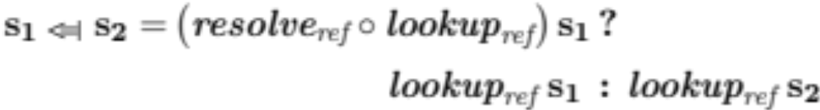

The Weak Hiding Combinator ( )
void foo();
namespace ns {
void foo(int);
}
void test() {
using ns::foo;
foo();
}
::
ns
Result:
Binds foo() to ::foo().
test

Slide 31
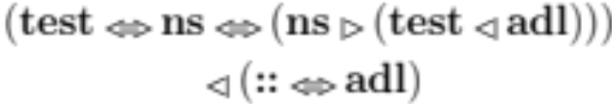
The Opening Combinator ( )
void foo();
namespace ns { void foo(int); }
namespace adl { struct X {};
void foo(typ); }
void test(adl::X x) {
using ns::foo;
foo(x);
}
::
ns
Result:
Finds ns::foo();
Enables ADL;
Binds foo(x) to adl::foo().
adl
test
Notes:
Same reasoning extends to weak hiding.
Fails to bind foo() – since ADL is N/A.
Binds foo(1) to ns1::foo().

Slide 32
The Opening Combinator ( )
void foo();
namespace ns { void foo(int); }
namespace adl { struct X {};
void foo(typ); }
void test(adl::X x) {
using ns::foo;
void foo();
foo(x);
}
::
ns
Result:
Finds test::foo();
Disables ADL;
Fails to bind foo(x).
adl
test
Notes:
Same reasoning extends to weak hiding.
Binds foo() to main::foo() – ADL n/a.
Binds foo(1) to ns1::foo().

Slide 33

The Combinators – Recap
Special cases of a “conditional” combinator.

Slide 34
Applications
Understanding current name binding mechanisms:
  Argument-dependent lookup (ADL).
  C++ operators.
  A cross-language analysis.
Exploring concepts designs
  Understanding the current limitations.
  Exploring new solutions:
    weak hiding,
    2-Stage name binding, and
    parameterized weak hiding.
Simplifying compiler designs.

Slide 35
ADL Example
namespace ns1 { struct X {};
void foo(X); }
namespace ns2 { void foo(int); }
void bar(ns1::X x) {
using ns2::foo;
foo(x);
}
void baz(ns1::X x) {
void foo(int);
foo(x);
{ // H
using ns2::foo;
foo(x);
}
}
In bar():
In baz():
In baz()’s inner scope, H:
ns1
ns2
bar
baz
H
::

Slide 36
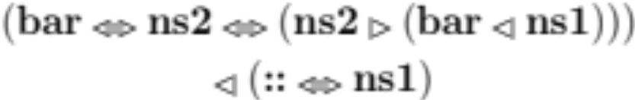
ADL Example
namespace ns1 { struct X {};
void foo(X); }
namespace ns2 { void foo(int); }
void bar(ns1::X x) {
using ns2::foo;
foo(x);
}
void baz(ns1::X x) {
void foo(int);
foo(x);
{ // H
using ns2::foo;
foo(x);
}
}
In bar():
In baz():
In baz()’s inner scope, H:
ns1
ns2
bar
::
Notes:
3.4.3.#3

Slide 37

ADL Example
namespace ns1 { struct X {};
void foo(X); }
namespace ns2 { void foo(int); }
void bar(ns1::X x) {
using ns2::foo;
foo(x);
}
void baz(ns1::X x) {
void foo(int);
foo(x);
{ // H
using ns2::foo;
foo(x);
}
}
In bar():
In baz():
In baz()’s inner scope, H:
ns1
baz
::
Notes:
3.4.3.#3
[baz == [] == ([] |- baz < ns1)] is same as [baz]

Slide 38
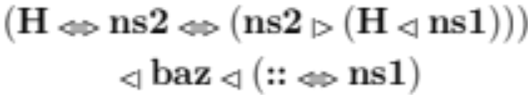
ADL Example
namespace ns1 { struct X {};
void foo(X); }
namespace ns2 { void foo(int); }
void bar(ns1::X x) {
using ns2::foo;
foo(x);
}
void baz(ns1::X x) {
void foo(int);
foo(x);
{ // H
using ns2::foo;
foo(x);
}
}
In bar():
In baz():
In baz()’s inner scope, H:
ns1
ns2
baz
H
::
Notes:
3.4.3.#3
[baz == [] == ([] |- baz < ns1)] is same as [baz]

Slide 39



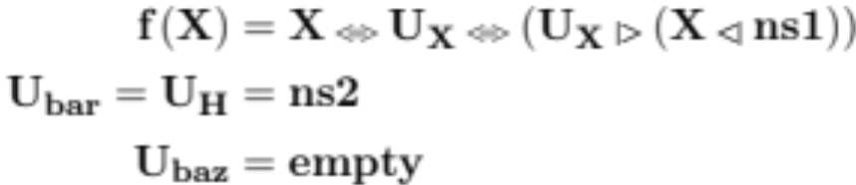
ADL Example
namespace ns1 { struct X {};
void foo(X); }
namespace ns2 { void foo(int); }
void bar(ns1::X x) {
using ns2::foo;
foo(x);
}
void baz(ns1::X x) {
void foo(int);
foo(x);
{ // H
using ns2::foo;
foo(x);
}
}
In bar():
In baz():
In baz()’s inner scope, H:
------------------- with -------------------
ns1
ns2
bar
baz
H
::
Notes:
3.4.3.#3 -- Abstracting out some complexity…
[baz == [] == ([] |- baz < ns1)] is same as [baz]

Slide 40
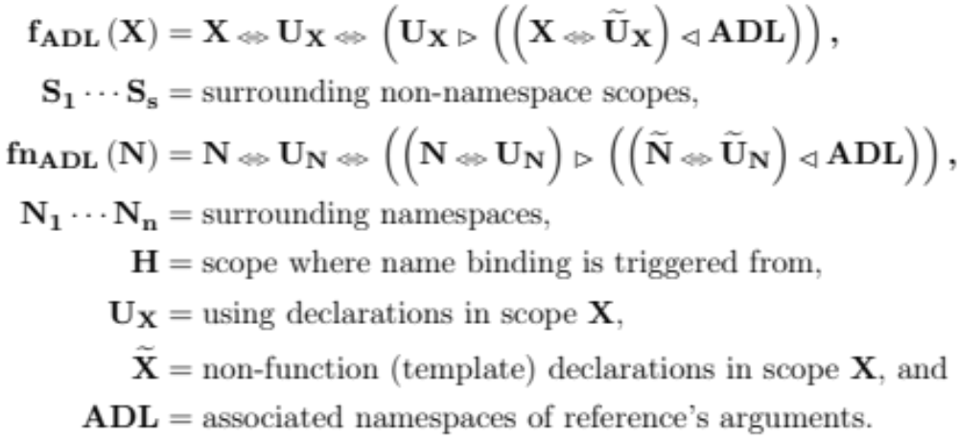
ADL Scoping Rules

Slide 41
ADL Scoping Rules when scope H is an inner namespace scope

Slide 42
ADL Scoping Rules when scope H is the outermost namespace scope
H = N_{n}

Slide 43
C++ Operators Example
struct X {}; struct Y {};
void operator+(X, X) { }
void operator+(X, Y) { }
void test(X x, Y y) {
void operator+(X, X);
x + x;
x + y;
operator+(x, x);
operator+(x, y);
}
test
::
Notes:
+ some implicit scopes, as specified by standard: 13.5, 13.6, 13.3.1.2…
* Built-in ops and members are considered before surrounding scopes.

Slide 44
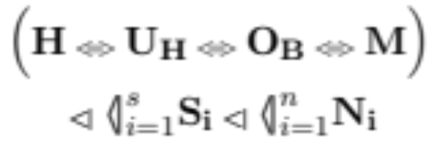
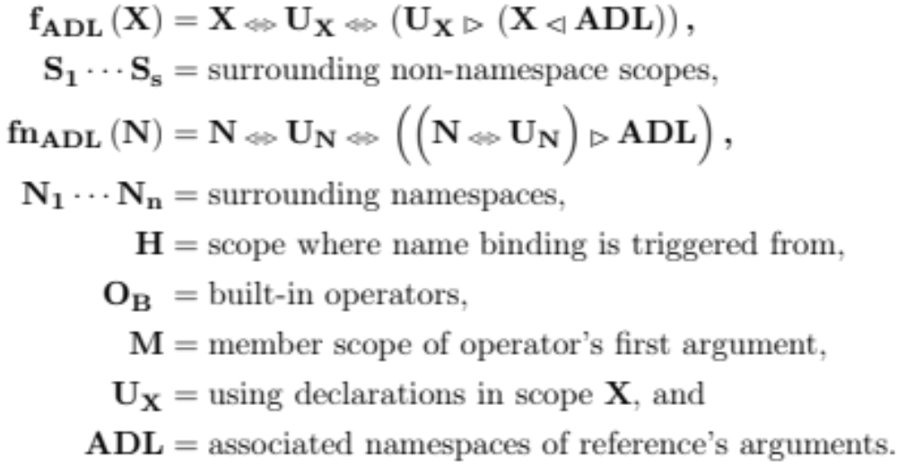
C++ Operators Scoping Rules without ADL
Notes:
* Qualified name lookup – not yet explored. → would extend M

Slide 45
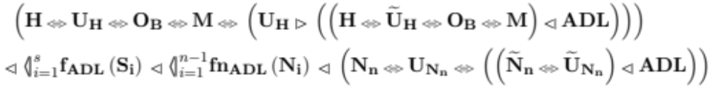
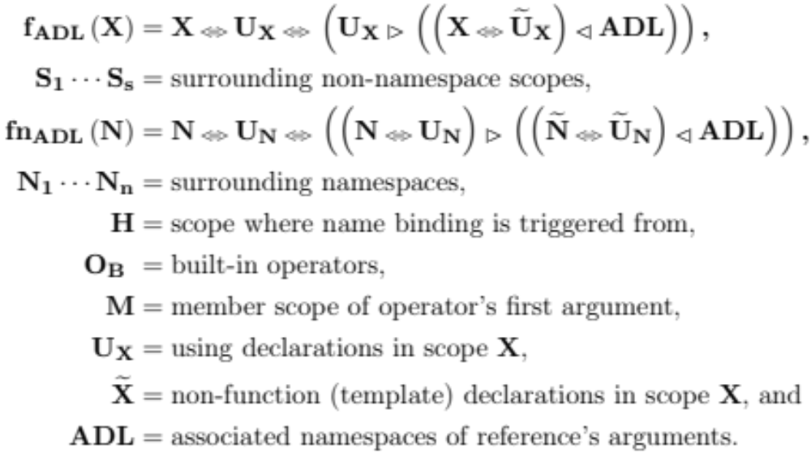
C++ Operators Scoping Rules with ADL
Empty, since operator is a reserved keyword.
Notes:
* Names of operators are usually reserved keywords. Thus tilde-X distinction is not strictly necessary.

Slide 46
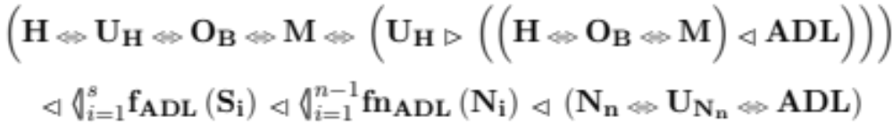
C++ Operators Scoping Rules with ADL

Slide 47
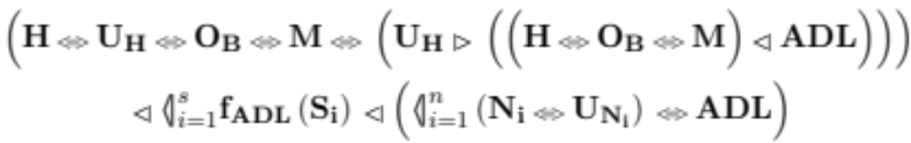
C++ Operators Scoping Rules with ADL

Slide 48
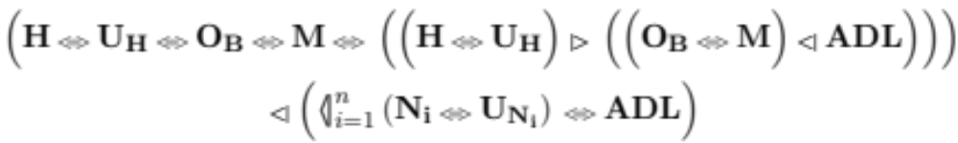
C++ Operators Scoping Rules when scope H is an inner namespace scope

Slide 49
C++ Operators Scoping Rules when scope H is the outermost namespace scope

Slide 50
Executing Scoping Rules
Use scope combinators.
void foo();
namespace adl { struct X {};
void foo(X); }
namespace ns { void foo(int); }
void test(adl::X x) {
using ns::foo;
foo(x);
}
Instantiate the Language concept.
Bind
Best viable candidate, or
error
Notes:
All of this is based on the fact that …
Express scoping rules via scope combinators
Execute those scoping rules by instantiating an abstraction of a programming language that we call the Language concept.

Slide 51
Elementary Name Binding
Scopes as sets of declarations.
lookup :: (…) => ref -> Set decl -> OverloadSet decl
lookup ref decls = Set.filter (match ref) decls
resolve :: (…) => ref -> OverloadSet decl -> Maybe decl
resolve ref decls = assess $ select_best_viable ref decls
assess :: (…) => BestViableSet decl -> Maybe decl
assess decls = case (Set.elems decls) of
[] -> Nothing
[decl] -> (Just decl)
_ -> ambiguity decls
Notes:
Using Haskell for simplicity…
Elementary scopes, before they are lifted into the representation expected for combinators,
Are sets of declarations.

Slide 52
Elementary Name Binding
What is the necessary minimal abstraction?
lookup :: (…) => ref -> Set decl -> OverloadSet decl
lookup ref decls = Set.filter (match ref) decls
resolve :: (…) => ref -> OverloadSet decl -> Maybe decl
resolve ref decls = assess $ select_best_viable ref decls
assess :: (…) => BestViableSet decl -> Maybe decl
assess decls = case (Set.elems decls) of
[] -> Nothing
[decl] -> (Just decl)
_ -> ambiguity decls

Slide 53
An Abstraction of PLs
The Language concept:
  match: How references match declarations.
  select_best_viable: How best viable candidates are determined.
  ambiguity: How to handle ambiguous results.

Slide 54
An Abstraction of PLs
The Ambiguity concept:
  ambiguity: How to handle ambiguous results.
The Language concept:
  match: How references match declarations.
  select_best_viable: How best viable candidates are determined.
  refines Ambiguity.
Notes:
For reasons of preciseness and genericity, we separate the meaning of ambiguity from the Language concept.

Slide 55
An Abstraction of PLs, Ext’d
The Ambiguity concept:
  ambiguity: How to handle ambiguous results.
The Language concept:
  match: How references match declarations.
  select_best_viable: How best viable candidates are determined.
  refines Ambiguity.
The Parameterized concept:
  expresses changes in the bind environment during name binding.
  e.g., changes in ambiguity for a variant of weak hiding.
Notes:
Later, representation for ambiguity will be extended by parameterization of weak hiding…

Slide 56
An Abstraction of PLs
class Ambiguity decl where
ambiguity :: ViableSet decl -> Maybe decl
ambiguity _ = Nothing -- default.
class Ambiguity decl => Language ref decl where
match :: ref -> decl -> bool
select_best_viable :: ref -> OverloadSet decl -> BestViableSet decl

Slide 57
An Abstraction of PLs, Ext’d
class Ambiguity decl where
ambiguity :: ViableSet decl -> Maybe decl
ambiguity _ = Nothing -- default.
class Ambiguity decl => Basic.Language ref decl where
match :: ref -> decl -> bool
select_best_viable :: ref -> OverloadSet decl -> BestViableSet decl
class (Parameterized decl, Basic.Language ref decl) =>
Language ref decl

Slide 58
Elementary Name Binding
assess requires the Ambiguity concept only,
gets the meaning of ambiguity from the language.
lookup :: (Language ref decl) => ref -> Set decl -> OverloadSet decl
lookup ref decls = Set.filter (match ref) decls
resolve :: (Language ref decl) => ref -> OverloadSet decl -> Maybe decl
resolve ref decls = assess $ select_best_viable ref decls
assess :: (Ambiguity decl) => BestViableSet decl -> Maybe decl
assess decls = case (Set.elems decls) of
[] -> Nothing
[decl] -> (Just decl)
_ -> ambiguity decls
Notes:
Lookup is also constrained by Ord decl…

Slide 59
Elementary Name Binding, Ext’d
assess requires no concept,
gets the meaning of ambiguity from the bind
environment.
resolve :: (Basic.Language ref decl) =>
BindEnv decl -> ref -> OverloadSet decl -> Maybe decl
resolve env ref decls = assess env $ select_best_viable ref decls
assess :: BindEnv decl -> BestViableSet decl -> Maybe decl
assess env decls = case (Set.elems decls) of
[] -> Nothing
[decl] -> (Just decl)
_ -> ambiguity env decls
Notes:
Depending on the parameterization, lookup may not change here.
For our interest only resolve changes… (with Basic.Language ref decl)

Slide 60
Applications
Understanding current name binding mechanisms:
  Argument-dependent lookup.
  C++ operators.
  A cross-language analysis.
Exploring concepts designs
  Understanding the current limitations.
  Exploring new solutions:
    weak hiding,
    2-Stage name binding, and
    parameterized weak hiding.
Simplifying compiler designs.

Slide 61
A cross language analysis
Instantiate the Language concept with different languages, designs and kinds of references:
  C++: function calls
    match = have_same_name + filter out types.
    select_best_viable = overload resolution (incl. viability check).
    ambiguity = ambiguity_is_error.
  C++: uses of types
    match = have_same_name.
    select_best_viable = viability check if single result, identity otherwise.
    ambiguity = ambiguity_is_error.
  C++: Multimethods proposal (cf. N2216)
    match = (same as function calls).
    select_best_viable = (same as function calls).
    ambiguity = ambiguity_is_not_error.

Slide 62
C++ Multimethods (Std. Doc. N2216) titled “Open Multi-Methods for C++”, Pirkelbauer et al., 2007
Relaxes the rules for ambiguity,
  allowing ambiguous calls when all best viable candidates “have a unique-base method through which the call can be dispatched”.
struct X, Y, Z;
void foo(virtual X&, virtual Y&); // (1)
void foo(virtual Y&, virtual Y&); // (2) – ** unique-base method **
void foo(virtual Y&, virtual Z&); // (3)
struct XY : X, Y {}
struct YZ : Y, Z {}
void foo(virtual XY&, virtual Y&); // (4) – overrider for (1) and (2)
void foo(virtual Y&, virtual YZ&); // (5) – overrider for (2) and (3)
XY xy; YZ yz;
foo(xy,yz); // both (4) and (5) are equally viable matches,
// w/ unique base (2)
Notes:
At compile time…
The paper goes into deeper details about how they actually make this happen.
The process involves using the unique base to seed the runtime dispatch table.

Slide 63
A cross language analysis
Instantiate the Language concept with different languages, designs and kinds of references:
  Haskell: name uses, excluding type inference
    match = have_same_name.
    select_best_viable = identity.
    ambiguity = ambiguity_is_error.
  Haskell: name uses, including type inference
    match = have_same_name.
    select_best_viable = viability check if single result, identity otherwise.
    ambiguity = ambiguity_is_error.
  Alternatives have different implications with weak hiding or Bind^{x2}.

Slide 64
Applications
Understanding current name binding mechanisms:
  Argument-dependent lookup.
  C++ Operators.
  A cross-language analysis.
Exploring concepts designs
  Understanding the current limitations.
  Exploring new solutions:
    weak hiding,
    2-Stage name binding, and
    parameterized weak hiding.
Simplifying compiler designs

Slide 65
Problem: Current Limitations
Current scoping rules break seemingly valid codes.
::
concept Foo2<typename P> =
requires (P a, P b) { foo(a, b); }
void foo(int) { }
template<Foo2 T>
void gen_func(T a, T b) {
foo(a, b);
foo(1);
}
Should Foo2<T>::foo()
shadow ::foo()? How?
Foo2<T>
Reject or accept the call foo(1)?

Slide 66
Practical Examples
STL: rotate() and move()
  Two function declarations, different number of parameters.
  Name lookup only finds one, type-check fails.
Plenoptic photography: Image rendering
  Two function declarations, different parameter types.
  Name lookup only finds one, type-check fails.
STL: common_type
  Two type (function) declarations, different type parameters.
  Name lookup only finds one, type-check fails.
Notes:
These are examples based on existing practical libraries that will need to transition from an unconstrained world to a constrained one.

Slide 67
STL: rotate() and move()
// Specialization adapted from latest release of libstdc++
template<RandomAccessIterator I>
requires Permutable<I> // has move(ValueType<I>&&)
I rotate (I first, I middle, I last) {
…
if (__is_pod(ValueType<I>) && (middle - first == 1)) {
ValueType<I> t = std::move(*p); //
std::move(p+1, p+last-first, p); //
*(p + last – first -1) = std::move(t); //
} // Ok w/ constrained std::move(), But…
… // Does not use the constraints.
}
Notes:
// cast to rvalue reference
template< class T >
typename std::remove_reference<T>::type&& move( T&& t );
// that iterates over a range…
template< class InputIt, class OutputIt >
OutputIt move( InputIt first, InputIt last, OutputIt d_first );
Libstdc++ == The GNU C++ Library
concept Permutable<ForwardIterator I> = Movable<ValueType<I>> && IndirectlyMovable<I, I>;

Slide 68
STL: rotate() and move()
// A novice’s approach
template<RandomAccessIterator I>
requires Permutable<I> // has move(ValueType<I>&&)
I rotate (I first, I middle, I last) {
…
if (__is_pod(ValueType<I>) && (middle - first == 1)) {
ValueType<I> t = move(*p); // Ok
move(p+1, p+last-first, p); // …
*(p + last – first -1) = move(t); // Ok
} // Compile error… or… Possible ADL issues…
…
}
Notes:
May have issues w/ ADL (?) – reason why std:: was needed to beginning with…
// cast to rvalue reference
template< class T >
typename std::remove_reference<T>::type&& move( T&& t );
// that iterates over a range…
template< class InputIt, class OutputIt >
OutputIt move( InputIt first, InputIt last, OutputIt d_first );
Libstdc++ == The GNU C++ Library
concept Permutable<ForwardIterator I> = Movable<ValueType<I>> && IndirectlyMovable<I, I>;

Slide 69
STL: rotate() and move()
// The right way…
template<RandomAccessIterator I>
requires Permutable<I> // has move(ValueType<I>&&)
I rotate (I first, I middle, I last) {
…
if (__is_pod(ValueType<I>) && (middle - first == 1)) {
ValueType<I> t = move(*p); // Ok
std::move(p+1, p+last-first, p); // Ok
*(p + last – first -1) = move(t); // Ok
} // Shadow or No Shadow… But…
… // Requires change in existing implementation.
}
Notes:
// cast to rvalue reference
template< class T >
typename std::remove_reference<T>::type&& move( T&& t );
// that iterates over a range…
template< class InputIt, class OutputIt >
OutputIt move( InputIt first, InputIt last, OutputIt d_first );
Libstdc++ == The GNU C++ Library
concept Permutable<ForwardIterator I> = Movable<ValueType<I>> && IndirectlyMovable<I, I>;

Slide 70
STL: rotate() and move()
// Update MoveWritable concept …
template<RandomAccessIterator I>
requires Permutable<I> // has std::move(ValueType<I>&&)
I rotate (I first, I middle, I last) {
…
if (__is_pod(ValueType<I>) && (middle - first == 1)) {
ValueType<I> t = std::move(*p); // Ok
std::move(p+1, p+last-first, p); //
*(p + last – first -1) = std::move(t); // Ok
} // Compile error… or… No ADL issues…
… // Maybe OK to not shadow?
} // std::move() is not a customization point.
Notes:
// cast to rvalue reference
template< class T >
typename std::remove_reference<T>::type&& move( T&& t );
// that iterates over a range…
template< class InputIt, class OutputIt >
OutputIt move( InputIt first, InputIt last, OutputIt d_first );
Libstdc++ == The GNU C++ Library
concept Permutable<ForwardIterator I> = Movable<ValueType<I>> && IndirectlyMovable<I, I>;

Slide 71
Plenoptic photo.: Image rendering
template<typename PixelType>
struct Radiance {
typedef typename
boost::multi_array<PixelType, 4> RadianceType;
RadianceType pixels; // 4D array of pixels
…
void Read(const string &ImageFile, …);
Radiance<PixelType> Render_Basic(…);
Radiance<PixelType> Render_Blended(…);
… // Several rendering variants …
void Print(const string& OutputFile, …);
…
}
Notes:
Capture an object in 3D → Collect pixels from different positions and direction in the 3D field of the scene,
rather than projecting the object into a 2D image. → more information about scene, more protography after capture.
Radiance(const string &ImageFile, // could be generic over input stream --> e.g., is_stream_iterator
2D image is 4D image with inner image of dims 1x1.
Rendering variants: weighted, depth-based, gpu, fft, etc… + necessary extensions from usual image manipulations
Depending on implementation, Lots of images pixels being passed around… Move whenever possible for efficiency.
→ We could rely on RVO (return value optimization) or other forms of copy-ellision-based optimizations,
and simply provide the right move constructors and assignment operators…
But copy elliision is automated and the behaviour is not uniform across different implementations…
So, we’ll make our moves explicit!

Slide 72
Plenoptic photo.: Image rendering
template<typename PixelType>
Radiance<PixelType> Radiance<PixelType>::Render_Blended(…) {
…
RadianceType Rendered(boost::extents[Iy][Ix][1][1]); …
for (…) { … // for each image pixel
PixelType pixel_avg; …
for (…) { … // for each direction
pixel_avg += pixels[ri][rj][rl][rm]; … // integrate pixel
} …
Rendered[i][j][0][0] = move(pixel_avg); …
}
return move(new Radiance<PixelType>(move(Rendered), Ix, Iy));
}
Notes:
const radiance_index Ix = Qx * patch_size, Iy = Qy * patch_size;
Pixel_avg and Rendered being temporary serve as perfect candidates for move semantics…
And so is the radiance object we construct at the end of the function.
This definition compiles. Now let’s make things safer by constraining the Radiance class template.

Slide 73
Plenoptic photo.: Image rendering
template<typename PixelType>
using MultiArrayIterator =
boost::multi_array<PixelType, 4>::iterator
// Add safety
template<Regular PixelType>
requires IndirectlyCopyable<MultiArrayIterator<PixelType>,
MultiArrayIterator<PixelType>>
struct Radiance {
typedef typename
boost::multi_array<PixelType, 4> RadianceType;
…
}
Notes:
template<Regular PixelType> // object (address-of), destruction,
// initialization (default constructor, copy constructor, copy assignment),
// allocation (new, delete), and equality_comparable,
requires IndirectlyCopyable<MultiArrayIterator<PixelType>, MultiArrayIterator<PixelType>>
// == Readable<MultiArrayIterator<PixelType>> &&
// SemiRegular<MultiArrayIterator<PixelType>> &&
// Writable<PixelType, MultiArrayIterator<PixelType>>; <-- move()

Slide 74
Plenoptic photo.: Image rendering
template<Regular PixelType> …
Radiance<PixelType>&& Radiance<PixelType>::Render_Blended(…) {
…
RadianceType Rendered(boost::extents[Iy][Ix][1][1]); …
for (…) { … // for each image pixel
PixelType pixel_avg; …
for (…) { … // for each direction
pixel_avg += pixels[ri][rj][rl][rm]; … // integrate pixel
} …
Rendered[i][j][0][0] = move(pixel_avg); … // Ok.
} // Compile error.
return move(Radiance<PixelType>(move(Rendered), Ix, Iy));
}
Notes:
Should I update all my existing implementations ?
std::move not found() because we are in restricted scope.

Slide 75
STL: common_type
concept Common<typename T, typename U> =
requires { common_type<T, U>::type; axiom (…) { … } };
template<typename T, typename U>
requires Common<T, U> && …
void gen_func(…) {
common_type<T, U>::type … // Ok.
common_type<int>::type … // Error.
common_type<int, double>::type … // Error.
common_type<int, double, char>::type … // Error.
}
Notes:
A variant of the proposed conceptualized STL concept that expands the definition of the CommonType type function.
Even if we used CommonType, who is to say that one would not have defined a variadic variant of it?
template< class... T >
struct common_type; // defined variadically.
template<typename T, typename U>
using CommonType = common_type<T, U>::type;

Slide 76
Solution: Weak Hiding
::
concept Foo2<typename P> =
requires (P a, P b) { foo(a, b); }
void foo(int) { }
template<Foo2 T>
void gen_func(T a, T b) {
foo(a, b);
foo(1);
}
Foo2<T>::foo()
should weakly hide
::foo()!
Foo2<T>
Accept the call foo(1)!
Notes:
Weak hiding = All candidates get a chance to compete. Those in inner scope get priority.

Slide 77
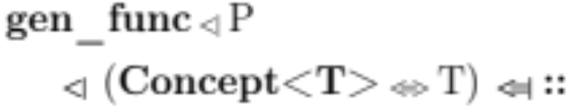
The Weak Hiding Scoping Rule
concept Foo2<typename P> =
requires (P a, P b) { … }
void foo(int) { }
template<Foo2 T>
void gen_func(T a, T b) {
foo(a, b);
foo(1);
}
Result:
Binds foo() to ::foo().
Foo2<T>
::

Slide 78
Implementing Weak Hiding
Implementation = Two-Stage Name Binding (Bind^{x2})
  Bind with inner scope: s1.
  Bind with outer scope: s2.
Bind^{x2} repeats name binding under different contexts.

Slide 79
Bind^{x2} for C++ Concepts
Within restricted scope:
  up to the outermost restricted scope.
  Disables ADL and some qualified name lookups.
In surrounding scope:
  normal lookup – including ADL.
concept Foo2<typename P> =
requires (P a, P b) { … }
void foo(int) { }
template<Foo2 T>
void gen_func(T a, T b) {
foo(a, b);
foo(1);
}
Foo2<T>
::

Slide 80
Applications
Understanding current name binding mechanisms:
  Argument-dependent lookup.
  C++ Operators.
  A cross-language analysis.
Exploring concepts designs
  Understanding the current limitations.
  Exploring new solutions:
    weak hiding,
    2-Stage name binding, and
    parameterized weak hiding.
Simplifying compiler designs

Slide 81
Inner Scope Ambiguity when ambiguity IS an error
concept Foo2<typename P> {
void foo(P, int);
void foo(int, P);
}
template<Foo2 T>
void gen_func(T a, int b) {
foo(b, b);
}
Current C++ Concepts:
Reject!

Slide 82
Inner Scope Ambiguity when ambiguity IS an error
concept Foo2<typename P> {
void foo(P, int);
void foo(int, P);
}
template<Foo2 T>
void gen_func(T a, int b) {
foo(b, b);
}
Proposed Extension:
Accept!
Notes:
In practice, we’d probably like this to be accepted.

Slide 83
Inner Scope Ambiguity when ambiguity IS an error
False
Repeat bind
Notes:
But even weak hiding, as currently defined, rejects this.

Slide 84
Inner Scope Ambiguity when ambiguity IS an error
False
Repeat bind
concept Foo2<typename P> {
void foo(P, int);
void foo(int, P);
}
template<Foo2 T>
void gen_func(T a, int b) {
foo(b, b);
}
Not Current C++ Concepts:
Reject or bind to unintended!

Slide 85
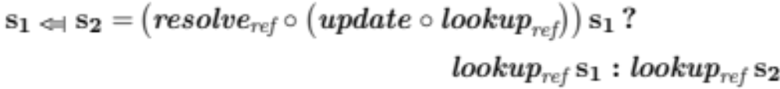
Inner Scope Ambiguity when ambiguity IS an error
True
temporary change in ambiguity
Do not repeat bind
concept Foo2<typename P> {
void foo(P, int);
void foo(int, P);
}
template<Foo2 T>
void gen_func(T a, int b) {
foo(b, b);
}
Current C++ Concepts:
Reject!
Notes:
Change the meaning of ambiguity in test only => tests if there is any viable candidate => replicates current C++ behavior.

Slide 86
Inner Scope Ambiguity when ambiguity IS NOT an error
True
Do not repeat bind
concept Foo2<typename P> {
void foo(P, int);
void foo(int, P);
}
template<Foo2 T>
void gen_func(T a, int b) {
foo(b, b);
}
Not Current C++ Concepts:
Accept!
Notes:
Changing the meaning of ambiguity all together.

Slide 87
Inner Scope Ambiguity when ambiguity IS NOT an error
False
Repeat bind
concept Foo2<typename P> {
void foo(P, int);
void foo(int, P);
}
template<Foo2 T>
void gen_func(T a, int b) {
foo(b);
}
Not Current C++ Concepts:
Accept unintended ambiguity!
Notes:
Behavior may not be desirable when there is no viable candidate in the constraints.

Slide 88
Ambiguity for C++ Concepts:
What is the most desirable?
Ambiguity IS an error, always?
Ambiguity IS NOT an error, always?
A middle ground option?
Rejects desirable, or binds to undesirable
Accepts undesirable
concept Foo2<typename P> {
void foo(P, int);
void foo(int, P);
}
template<Foo2 T>
void gen_func(T a, int b) {
foo(b, b); foo(b);
}
Proposed Extension:
Accept only desirable! (?)

Slide 89
Ambiguity for C++ Concepts
Our proposed extension
Ambiguity IS NOT an error, when in restricted scope.
  Similar to multimethods proposal N2216.
Ambiguity IS an error, otherwise.
concept Foo2<typename P> {
void foo(P, int);
void foo(int, P);
}
template<Foo2 T>
void gen_func(T a, int b) {
foo(b, b); foo(b);
}
Proposed Extension:
Accept only desirable!

Slide 90
Revisiting Hinnant’s Example
Cf. C++ standard documents:
  C++ Library Reflector message c++std-lib-20050
  N2576: “Type-Soundness and Optimization in the Concepts Proposal”, Douglas Gregor, March 2008.
Question: How to type-check constrained templates?
template <class T>
requires std::DefaultConstructible<T> && std::Addable<T> && std::Convertible<T::result_type,T> && std::CopyConstructible<T>
void test() {
T s1;
T s2;
T s3 = s1 + s2 + T() + T() + T();
}
int main() { test<string>(); }
Notes:
Howard Hinnant:
How to check this given appropriate implementation of a “string” class and + operators.
There were other similar examples at the time…

Slide 91
Hinnant’s Example: Problem
The desired (optimized) output
  is observed with unconstrained templates, but
  is not observed with constrained templates.
Unconstrained:
lv string + lv string
rv string += rv string
rv string += rv string
rv string += rv string
Constrained:
lv string + lv string
lv string + lv string
lv string + lv string
lv string + lv string
auto concept Addable<typename T, typename U=T> {
typename result_type;
result_type operator+(T const&, U const&);
}
template <class T>
requires … std::Addable<T> …
void test() {
T s1;
T s2;
T s3 = s1 + s2 + T() + T() + T();
}
int main() { test<string>(); }
Notes:
The Addable concept was defined as follows, and at the time,
Concepts requirements were satisfied by exact matching… → loss of optimization.

Slide 92
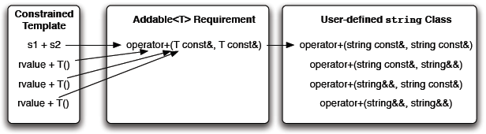
Hinnant’s Example in Pictures
auto concept Addable<typename T, typename U = T> {
typename result_type;
result_type operator+(T const&, U const&);
}
Notes:
The Addable concept was defined as follows, and at the time,
Concepts requirements were satisfied by exact matching… → loss of optimization.
Doug: Explore different solutions,
→ 2 main solutions, centered around how to satisfy the requirements of concepts.

Slide 93
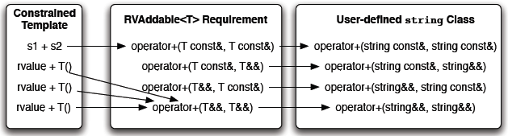
Hinnant’s Example: Solution 1
Manual Introduction of Overloads
auto concept RVAddable<typename T, typename U = T> {
typename result_type;
result_type operator+(T const&, U const&);
result_type operator+(T const&, U&&);
result_type operator+(T&&, U const&);
result_type operator+(T&&, U&&);
}

Slide 94
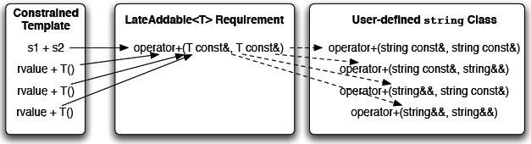
Hinnant’s Example: Solution 2
“Eliminating” Forwarding Functions
auto concept LateAddable<typename T, typename U = T> {
typename result_type;
result_type operator+(T const&, U const&);
}
concept_map LateAddable<string> {
typedef string result_type;
string operator+(T const& x, T const& y) { return x + y; }
}
Notes:
Concept map pulls all potentially matching declarations using a well-defined seed.

Slide 95
Revisiting the Proposed Solutions
Manual introduction of overloads:
“Eliminating” forwarding functions:
Notes:
1: verbosity – anticipating the future…
2: over-generalized?
A lot of work and thought went into this before, but I can’t help but get a sense that these two alternatives were extremes of
a “sweet middle” solution – kind of the same way we decided we wanted weak hiding.

Slide 96
A “Sweet Middle” Alternative?
auto concept SweetAddable<typename T, typename U = T> {
typename result_type;
result_type operator+(T const&, U&&);
result_type operator+(T&&, U const&);
}
concept_map SweetAddable<string> {
typedef string result type;
result_type operator+(T const& x, U&& y) { return x + y; }
result_type operator+(T&& x, U const& y) { return x + y; }
}
Constrained Templates
s1 + T()
rvalue + T()
rvalue + s2
SweetAddable<T> Requirement
operator+(T const&, T&&)
operator+(T&&, T const&)
(ANY)
User-defined string class
operator+(string const&, string const&)
operator+(string const&, string&&)
operator+(string&&, string const&)
operator+(string&&, string&&)
Notes:
At least just for experimental purposes.
User gets to say exactly what s/he means, without risks of over-generalizing
Concept modeling picks up all declarations but the first one, which expects only l-values as inputs.

Slide 97
A “Sweet Middle” Example
Minimizing and clarifying template constraints
template <class T>
requires … std::SweetAddable<T> …
void test() {
T s1;
T s2;
T s3 = s1 + T() + T() + s2;
}
int main() { test<string>(); }
Constrained Templates
s1 + T()
rvalue + T()
rvalue + s2
SweetAddable<T> Requirement
operator+(T const&, T&&)
operator+(T&&, T const&)
(ANY)
User-defined string class
operator+(string const&, string const&)
operator+(string const&, string&&)
operator+(string&&, string const&)
operator+(string&&, string&&)
Notes:
Let’s go back to Hinnant’s example that we had earlier, and make a few adjustments…
Recall that we always want to constraint templates with as minimal requirements as possible.
The two requirements in SweetAddable are all that one should need, if possible.

Slide 98
Current C++ Concepts: Problem
Clarity is penalized.
  Minimal requirement specification leads to ambiguity,
  which is an error in a constrained template definition,
  even though instantiation guarantees single matches.
Limited control over candidate sets.
  Either one or all possible candidates.
The “sweet middle” alternative is not allowed.

Slide 99
C++ Concepts: Proposed Extension
Ambiguity is not an error, when in restricted scope.
Ambiguity remains as defined in the language, otherwise.
➔ Parameterize weak hiding over the bind environment.

Slide 100
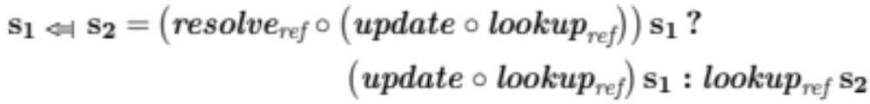
The Combinators, Revisited
Weak hiding selectively updates lookup results
Define update based on a new concept: Parameterized.
update :: (Parameterized decl) => OverloadSet decl -> OverloadSet decl
update (os, env) = case get_env of
Nothing -> (os, env)
(Just new_env) -> (os, new_env)
Lookup results are coupled with the bind environment.
Notes:
Nothing -> update could be modified to throw runtime exceptions and reinforce that a system supports weak hiding.
(Just new_env) -> build_overload_set (lookup_results os) env

Slide 101
Parameterized example
Bind environment
class Parameterized decl where
get_env :: Maybe (ViableSet decl -> Maybe decl)
get_env = Nothing -- default, constant bind env.
class (Ambiguity decl, Parameterized decl,
Basic.Language ref decl) => Language ref decl
instance Ambiguity decl where
ambiguity = ambiguity_is_error
instance Parameterized decl where
get_env = Just (ambiguity_is_not_error)
For C++ Concepts
Notes:
Parameterized meaning of ambiguity is captured by “update”.

Slide 102
Exploring Concepts Designs: Recap
Introducing a new scoping rule: Weak Hiding.
Introducing a new mechanism for name binding: Bind^{x2}.
Main Motivation:
  Software compatibility
  In transition from unconstrained to constrained polymorphism.
    e.g., a transition from C++ to ConceptC++.

Slide 103
Exploring Concepts Designs: Recap
Bind^{x2} is an implementation of weak hiding, optionally parameterized (e.g., over the bind environment).
Design variants: (Experimental)
  Constant meaning of ambiguity: from Ambiguity concept.
  Changing meaning of ambiguity: from bind environment.
    e.g., Relaxing restrictions for name binding in restricted scope.

Slide 104
Applications
Understanding current name binding mechanisms:
  Argument-dependent lookup.
  C++ Operators.
  A cross-language analysis.
Exploring concepts designs
  Understanding the current limitations.
  Exploring new solutions:
    weak hiding,
    2-Stage name binding, and
    parameterized weak hiding.
Simplifying compiler designs

Slide 105
Using our Framework in Compilers
Option #1: For all combinators, integrate directly into parsers
A parser interface: manages scopes and declarations.
void foo();
namespace adl { struct X {};
void foo(X); }
namespace ns { void foo(int); }
void test(adl::X x) {
using ns::foo;
foo(x);
}
Instantiate the Language concept.
Bind
Best viable candidate, or
error
Notes:
Parser interface:
manages entries into and exits from scopes, new declarations, and triggers name binding with appropriate input data (builds scopes).

Slide 106
Using our Framework in Compilers
Option #2: for weak hiding only, a conservative integration
concept Foo2<typename P> =
requires (P a, P b) { … }
void foo(int) { }
template<Foo2 T>
void gen_func(T a, T b) {
foo(a, b);
foo(1);
}
Bind^{x2}
Best viable candidate, or
error
Notes:
Conservative approach

Slide 107
Prototypes Underway
[ https://github.iu.edu/lvoufo/BindIt ]
Parser interface for managing scopes:
  Using Haskell’s Parsec library and a mini-C++ language.
  Modifying existing compilers: language-c, featherweight Java, etc...
Executing Bind^{x2}:
  Explored in ConceptClang.
Alternative compositional view of name binding
  as composed of some lookup_best and assess.

Slide 108
Recap
Our name binding framework allows:
  expressing the scoping rules of a language, for a given reference, in terms of 3-4 scope combinators, and
  reasoning about the application of scoping rules generically, abstracting over the Language concept
    incl. the Ambiguity and, optionally, Parameterized concepts.
2-stage name binding (Bind^{x2}):
  is an implementation of weak hiding, optionally parameterized by the bind environment, and
  preserves valid programs in transition from C++ to ConceptC++.

Slide 109
Thank You! Questions/Comments?
Use scope combinators.
::
void foo();
namespace adl { struct X {};
void foo(X); }
namespace ns { void foo(int); }
void test(adl::X x) {
using ns::foo;
foo(x);
}
adl
Instantiate the Language concept.
ns
test
Bind
Best viable candidate, or
error
[ https://github.iu.edu/lvoufo/BindIt ]

